Slide 1
AutoGenMCQ:
Streamlining Education with
Smart MCQ Generation
2

Slide 2
INTRODUCTION
Welcome to the MCQ Generator Project presentation!
Our project introduces an automated system for generating Multiple Choice Questions (MCQs) using LangChain and OpenAI's language models.
By leveraging advanced Natural Language Processing (NLP) techniques, we streamline quiz creation for educators and students.
Through modular coding and automation, we offer a user-friendly solution for personalized quiz generation.
Join us as we revolutionize MCQ creation in education.

Slide 3
IMPORTANCE
Time-Saving Efficiency
Personalized learning experiences
This scalability is particularly beneficial in educational settings with large student populations or diverse learning needs, where quizzes need to be tailored to different levels of proficiency.
Educators can easily modify parameters such as subject matter, question difficulty, and question types to align with changing teaching objectives and student requirements, enhancing the adaptability and relevance of quizzes over time.
Empowering Every Educator
Scalable Evaluation
Automated MCQ generation empowers educators of all sizes, including individual tutors and small teaching groups.
Automated MCQ generation scales effortlessly to meet the demands of large institutions with high student populations. It enables educators to efficiently create quizzes tailored to diverse learning needs, optimizing the educational experience for a wide range of students.
4

Slide 4
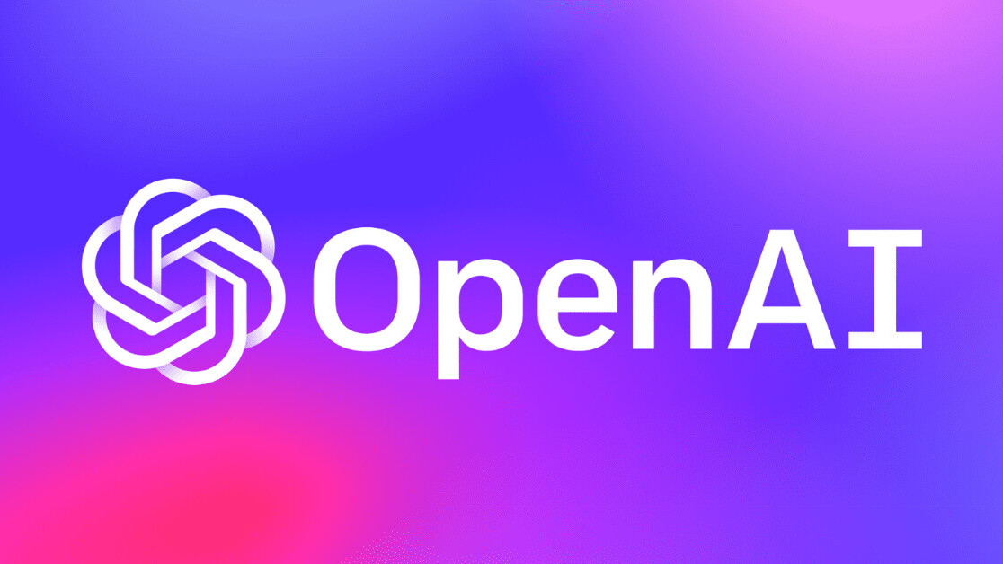
OVERVIEW OF LLM
A Language Model (LLM) is a computer program designed to understand human language and generate human-like text based on input.
OpenAI's GPT-3.5 Turbo:
Description: GPT-3.5 Turbo is one of the most advanced Language Models (LLMs) developed by OpenAI. It is a variant of the Generative Pre-trained Transformer (GPT) series, renowned for its ability to understand and generate human-like text with high accuracy and fluency.
The OpenAI API is a platform provided by OpenAI that allows developers to access their pre-trained language models.
5

Slide 5
OPEN AI API KEY
The OpenAI API key is a unique authentication token and serves as a credential for accessing OpenAI's language models and other services through their API endpoints.
Limitations
The OpenAI API operates on a pay-per-use model, potentially incurring costs for extensive usage.
Real-time outputs are not provided by the OpenAI API; instead, it relies on pre-trained models.
LangChain offers an alternative by leveraging free language models and APIs, providing similar functionalities without costs.

Slide 6
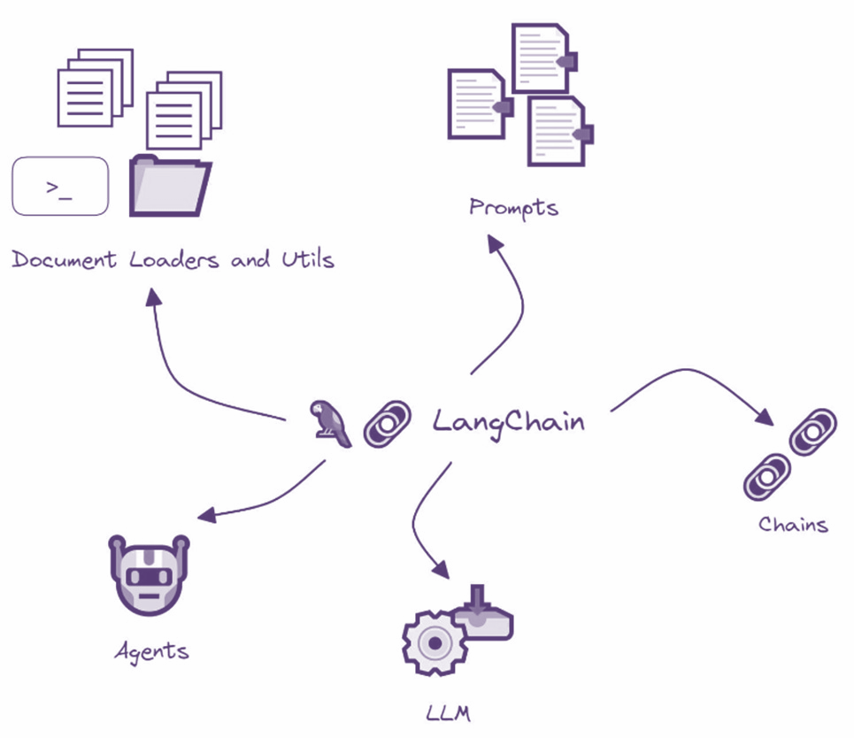
LANGCHAIN
Langchain is an open-source framework designed for developing applications powered by language models and provides tools for handling context and reasoning.
7

Slide 7
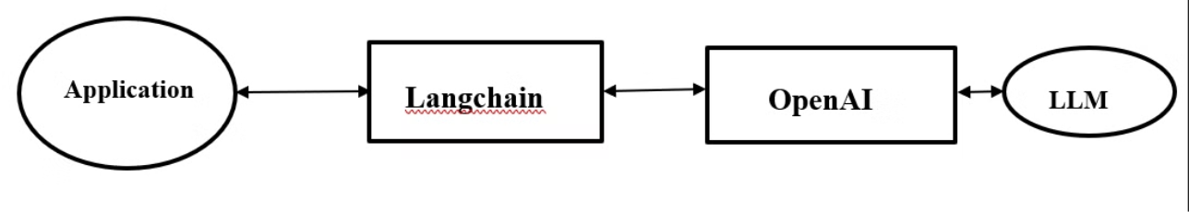
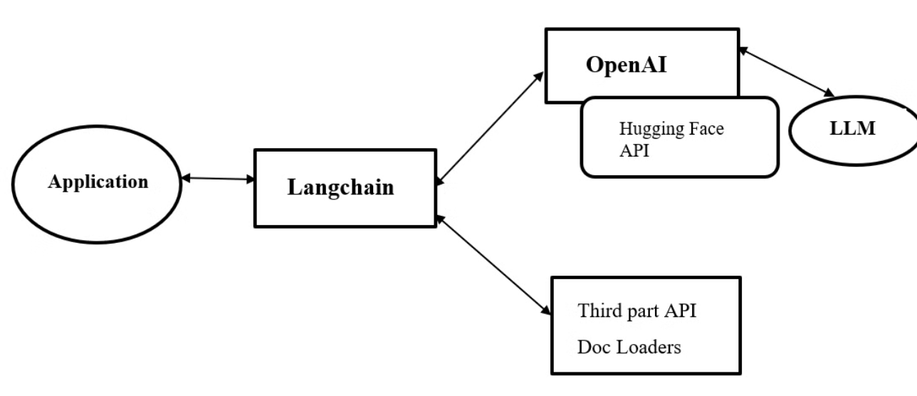
USE OF LANGCHAIN
8

Slide 8
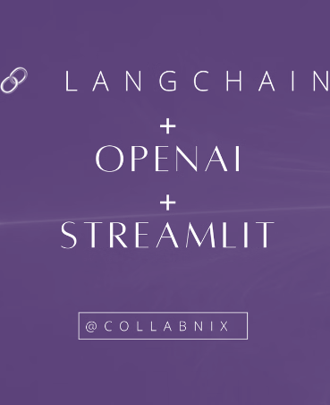
STREAMLIT APP
Streamlit is a free, open-source Python library that allows users to create interactive web apps from Python scripts.
Streamlit enables developers to incorporate interactivity into their apps using widgets such as sliders, buttons, and text inputs and media.
9

Slide 9
AGENDA
1
Dependency Installation
2
OpenAI API Integration
3
Data Acquisition & Preprocessing
4
Model Integration
5
Model Training
6
MCQ Generation
7
Evaluation and Review
8
Streamlit Application Development
Result & conclusion
10
9

Slide 10
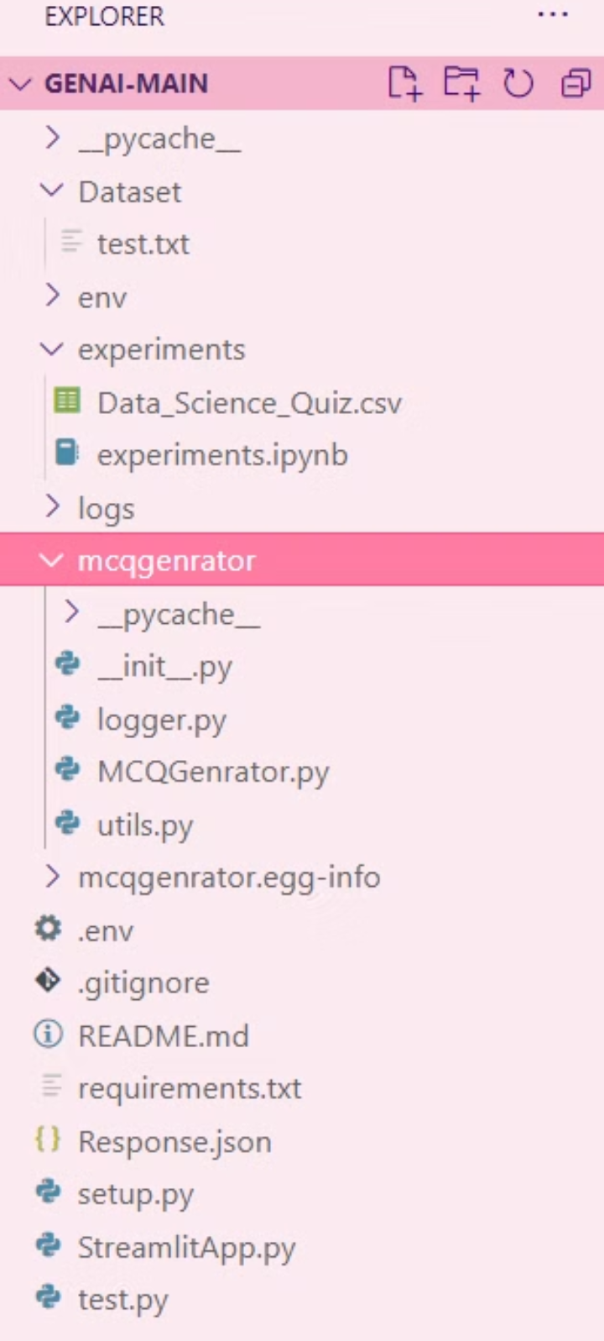
Project structure overview:
Root Directory Components:
.gitignore: Specifies untracked files to ignore in version control.
.env: Configuration file for environment variables.
README.md: Markdown file containing project information.
requirements.txt: Lists required Python packages.
setup.py: Script for packaging the Python project.
test.txt: Text file containing training data for model evaluation.
Experiments Directory
Data_Science_Quiz.csv: CSV file containing generated MCQs.
experiments.ipynb: Jupyter Notebook for conducting experiments.
MCQGenerator Directory:
init.py: Initialization file for the Python package.
logger.py: Module responsible for saving logs.
MCQGenerator.py: Module for generating multiple-choice questions.
utils.py: Module containing utility functions.
StreamlitApp.py:
A file containing the Streamlit application code.
Responsible for creating the user interface and integrating functionality from other modules.
11
.

Slide 11
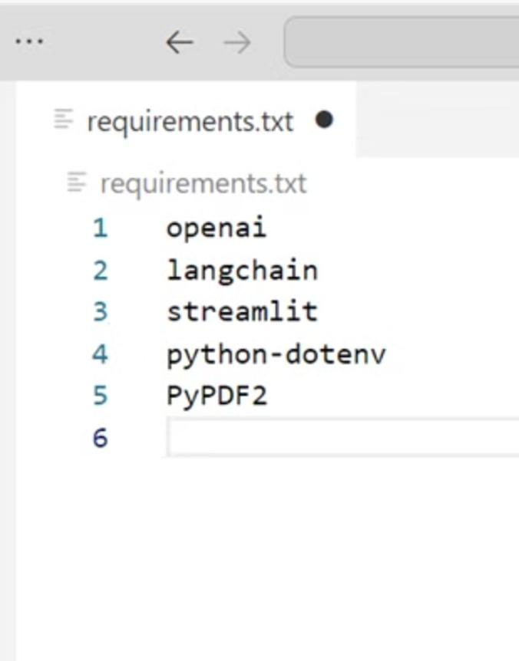
DEPENDENCY INSTALLATION
The first step is to creating a virtual environment then it's crucial to install all the required Python packages listed in the requirements.txt file.

Slide 12
DATA ACQUISITION & PRE-PROCESSING
Gathering Data
Data Preprocessing
Our methodology includes gathering raw textual data from diverse sources like TXT or PDF files.
Data preprocessing involves using Python libraries like PyPDF2 to extract information from the text files, encompassing reading text & formatting data for the language model input.

Slide 13
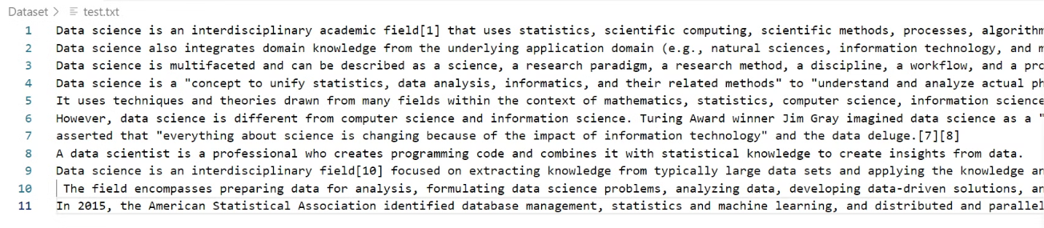
DATASET
14

Slide 14
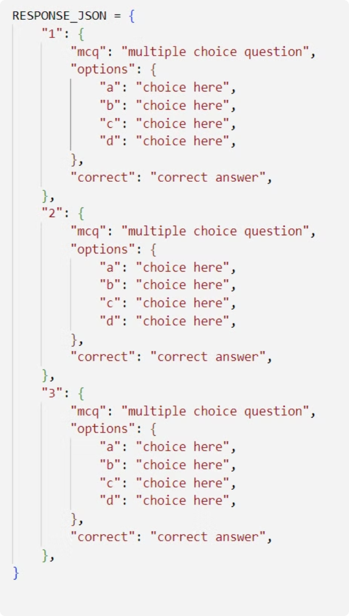
MODEL INTEGRATION
Initialization of LangChain Model
We initialized the LangChain model using the ChatOpenAI class.
The initialization involved passing the OpenAI API key and configuring model settings such as temperature and model name.
Definition of RESPONSE_JSON Object
This object serves as a template for generating MCQ responses in a structured format.
15

Slide 15
Model Training
Prompt Template & Chain Creation
16

Slide 16
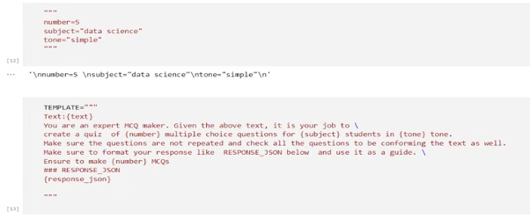
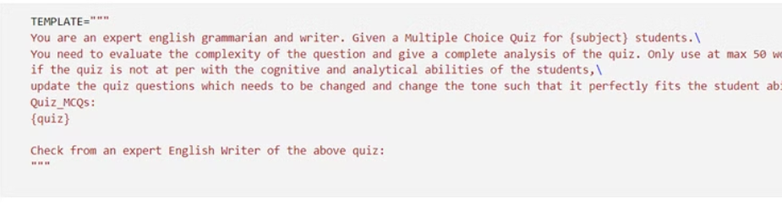
TWO TEMPLATES:
We created two templates, one for generating multiple-choice questions (MCQs) and another for evaluating them.
The first template, named quiz_generation_prompt, guides the model in generating MCQs based on input variables.
The second template, named quiz_evaluation_prompt, instructs the model in evaluating the complexity and suitability of the generated MCQs.

Slide 17
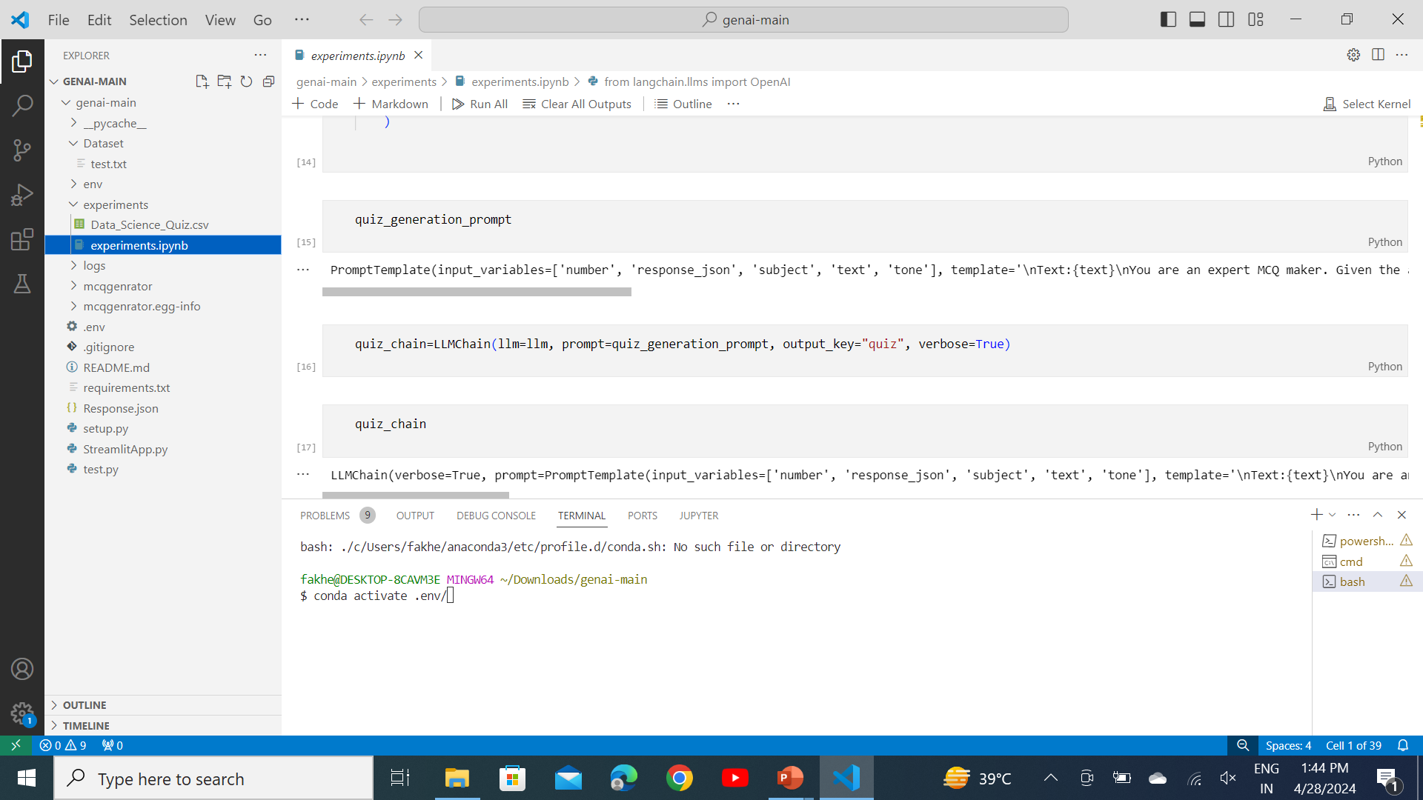
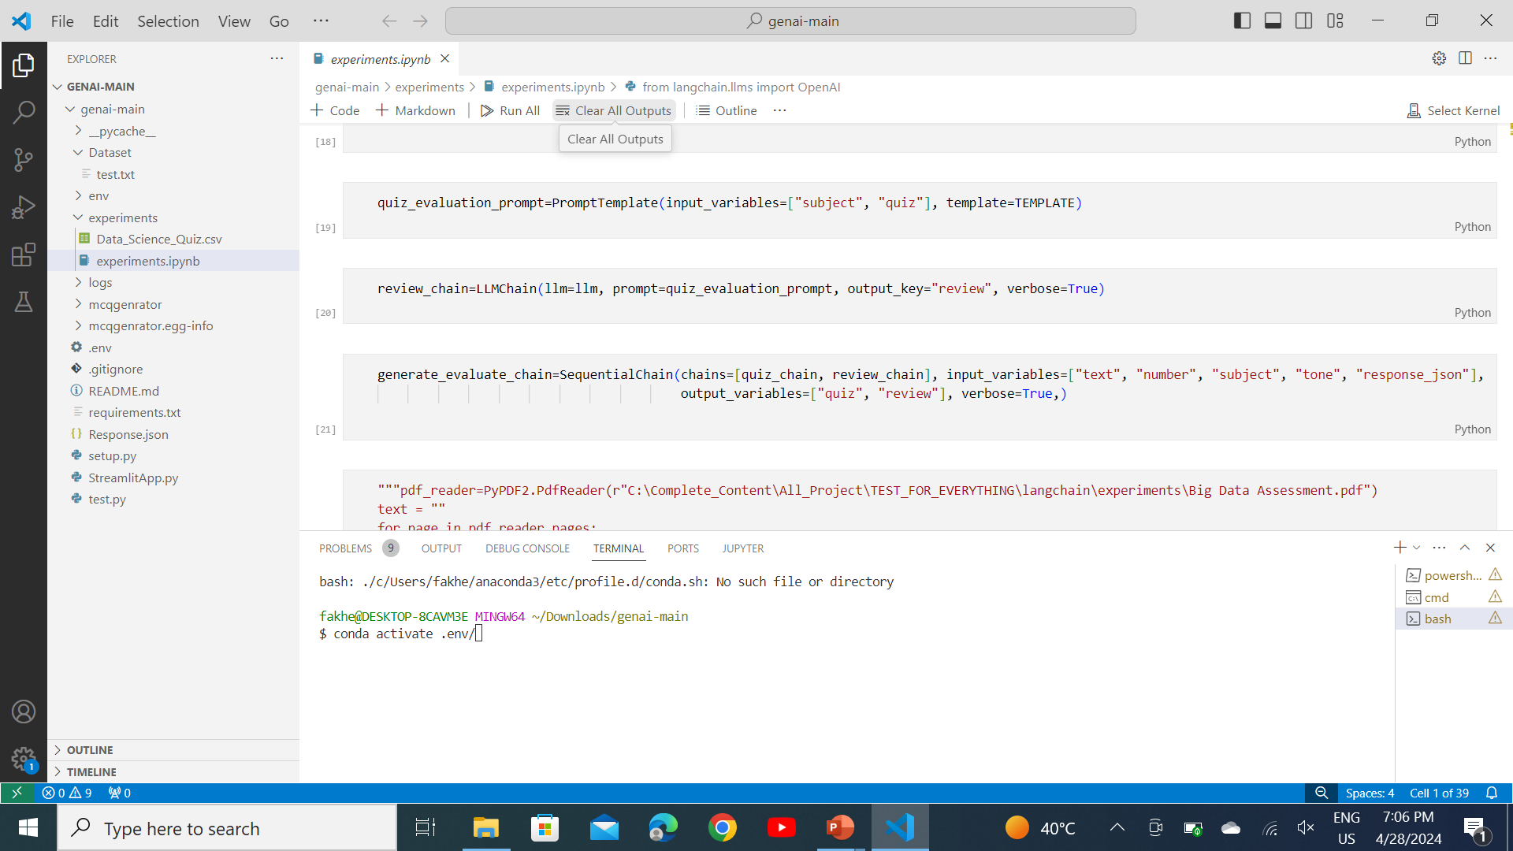
TWO CHAINS
The quiz_chain orchestrates the process of generating MCQs using the quiz_generation_prompt
template.
The review_chain evaluates the generated MCQs using the quiz_evaluation_prompt template.
And lastly, We establish a sequential chain named generate_evaluate_chain to connect the
MCQ generation and evaluation chains in a sequential manner.

Slide 18
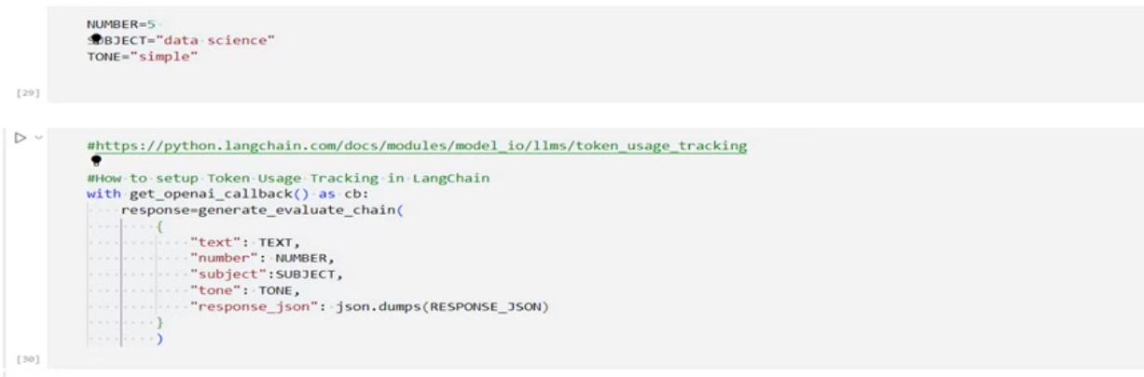
MCQ GENERATION & EVALUATION
Sequential Chain Configuration:
Initialize the input parameters mcq_count, grade, and tone with appropriate values to specify the number of MCQs to generate, the grade level, and the tone of the MCQs, respectively.
It integrates token usage tracking functionality from LangChain. Tokens serve as units of computation consumed by the OpenAI API.
The response variable stores the output of the chain, comprising the generated MCQs and their evaluations.
19

Slide 19
STREAMLIT APPLICATION DEVELOPMENT
Purpose:
Integrated Streamlit for user-friendly interface in MCQ generation system.
1
2
Components Utilized:
Implemented text inputs, file uploader, and form submission for user interaction.
Utilized Streamlit's reactive features for real-time updates based on user input.
3
Data Visualization:
Incorporated Streamlit's charting capabilities to display generated MCQs in a table format.
Allowed users to visualize quiz data using Streamlit's interactive components.
20

Slide 20
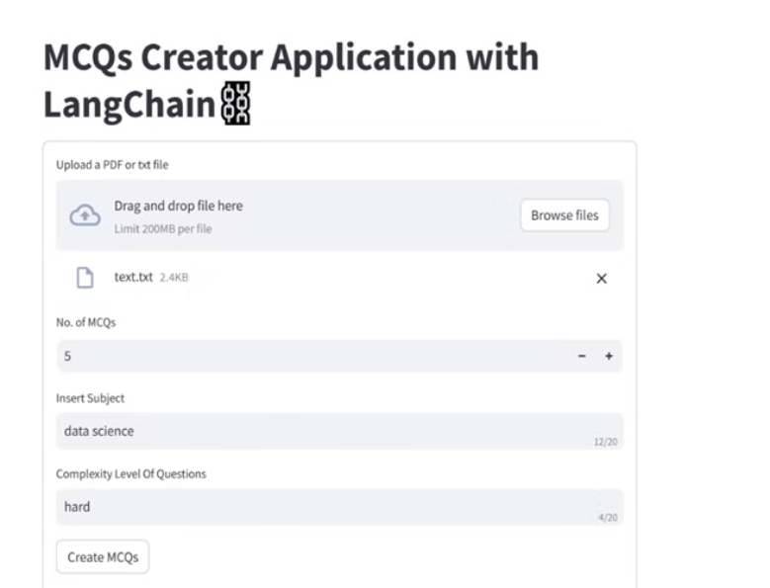
RESULT & CONCLUSION
Streamlit Application Interface:
The Application Interface Provides Users With An Intuitive Platform To Interact With The MCQ Generation System.
It Includes Interactive Components For Inputting Text, Specifying The Number Of Mcqs, Selecting The Subject, And Setting The Complexity Level Of Questions.

Slide 21
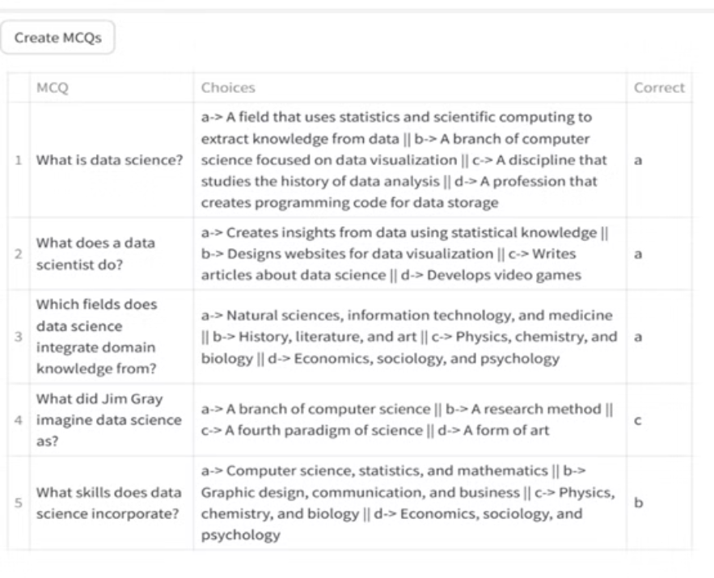
OUTPUT OF GENERATED MCQS
It provides a comprehensive set of questions tailored to the specified subject and complexity level.
22

Slide 22
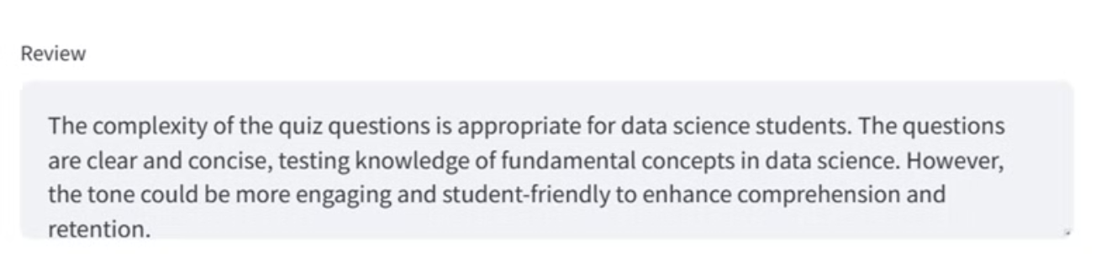
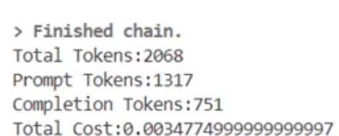
OUTPUT OF REVIEW PANEL
The review panel in the Streamlit application provides users with valuable feedback and insights into the generated multiple-choice questions (MCQs).

Slide 23
CONCLUSION
In conclusion, the automated MCQ generation pipeline offers a scalable and innovative solution to the challenges faced by educators in creating quizzes.
1
2
In conclusion, undertaking this project has been a tremendous learning journey.
By leveraging cutting-edge technology, this project empowers educators to deliver engaging and effective assessments, ultimately enhancing the learning experience for students.
It has provided us with valuable insights into cutting-edge technologies such as generat

Slide 24
THANK YOU
For your time and attention during this presentation.
We welcome any questions or feedback you may have.

